Slide 1
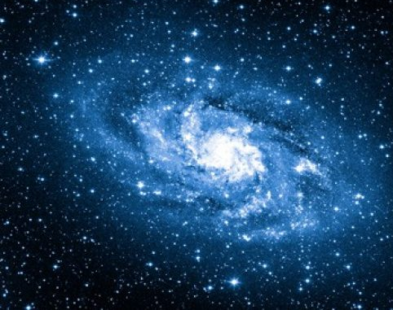
Expander Codes
17EC10009 : B. Sri Charan
17EC10041 : Pranav Joshi

Slide 2
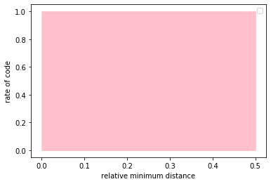
Motivation
All the possible rate- relative minimum distance shown here. The block length is very large. We consider the case where the relative minimum distance is less than 0.5
The quest is to find a code that achieves high rate and high relative minimum distance. The ideal point is (0.5,1) in here.

Slide 3
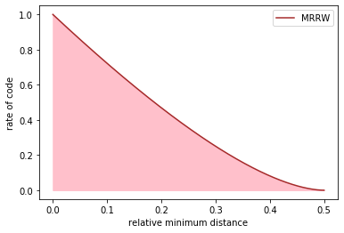
An upper bound
The MRRW eliminates the possibility of codes in the white region. It is impossible to achieve rate and minimum relative distance in the white region simultaneously. However, the existence of codes in pink region is not guaranteed yet.

Slide 4
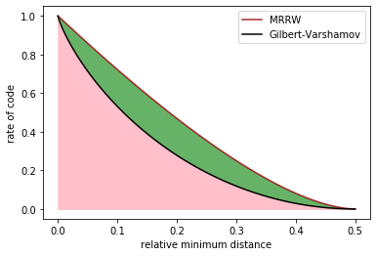
A lower bound
GV bound ensures the existence of codes below the curve given (the optimal rate for a given relative minimum distance lies on or above the black curve).
It is impossible for a code to exist in white region. Every point in pink region admits a code. The green region is of uncertainty.

Slide 5
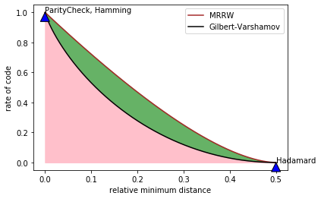
Where do codes tend to exist?
Codes usually show high rate at the cost of distance or high min distance at the cost of rate.
It is not trivial to construct codes that lie in the pink region even for low rates and distances. Such codes are called Asymptotically good codes

Slide 6
Why expander codes?
Although codes are found that lie in the pink region, most of them are not explicitly constructed
Concatenated codes and Expander based codes are the only asymptotically good codes to date that are built explicitly
The problem with concatenated codes is that they need two other classes of codes to be constructed. Expander codes use either no code or only one code of other class.

Slide 7
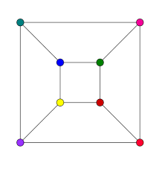
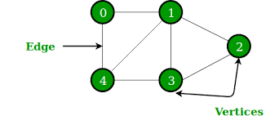
Graphs Regular graphs
3-regular graph
G is charachterised by vertices V and edges E.
All vertices have equal number of edges

Slide 8
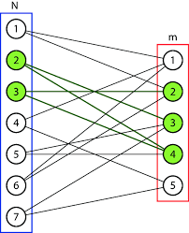
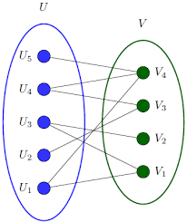
Bipartite graphs
Characterized by two disjoint sets of vertices L, R.(V = L U R)
L and R doesn't have edges within themselves.
They are two-colorable graphs
Left D-regular bipartite graph, D=2

Slide 9
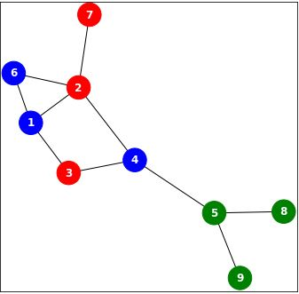
Neighborhood
For a subset S of vertices of a graph G, set of all vertices which don't lie in S and have an edge with at least one vertex in S is called a neighborhood of S and is denoted by N(S)
If a vertex in N(S) has only vertex in S as a neighbor, it is called a unique neighbor of S. Set of all unique neighbors of S is denoted by U(S)
In the figure, Let S= {2,3,7} . Then, N(S)={1,4,6} and U(S)={6}

Slide 10
Bi-adjacency Matrix
When a bipartite graph G(L U R, E) is given and |L|=n, |R|=m; The Bi-adjacency of G (denoted by H) is constructed as follows:
Give an ordering to vertices in both L and R
The matrix H has m rows and n columns
The element in ith row and j th column is 1 if ith vertex in R and j th vertex in L has an edge between them

Slide 11
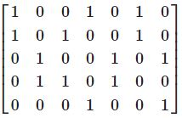
Bi-adjacency Matrix

Slide 12
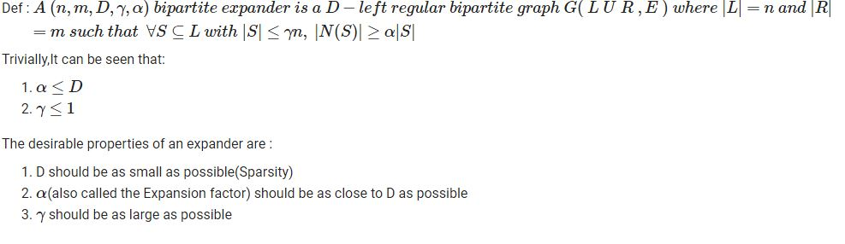
Bipartite Expander Graphs
If for every sufficiently small set in left partition of a bipartite graph, sufficiently large neighboring set exists, such a graph is called an expander.

Slide 13
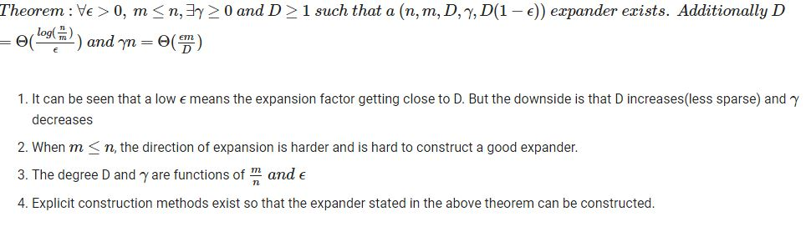
Existence of an Expander

Slide 14
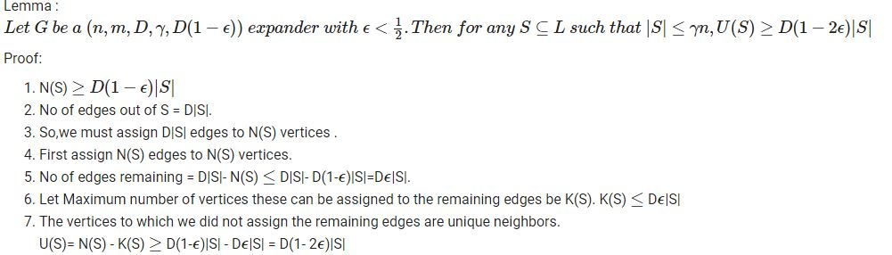
Unique neighbors for an Expander
The following result shows that for an expander, atleast one unique neighbor exists for a set of the size dictated by the expander property.

Slide 15
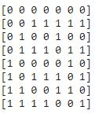
Graphs to Codes
If a D-left regular bipartite graph G(L U V, E)is given, a linear code C with block length n can be constructed.
Just take the biadjacency matrix of G as the parity check matrix of C
Similarly if parity check matrix of C is given, a bipartite graph can be constructed. It's called Factor Graph of C.
Code words for this graph

Slide 16
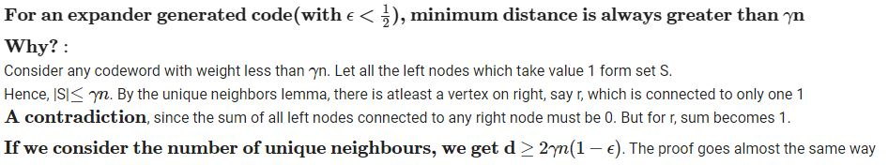

Minimum relative distance

Slide 17
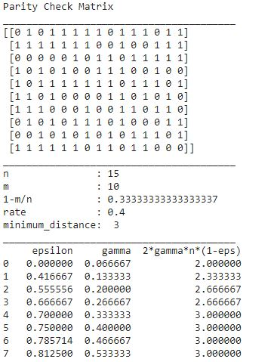
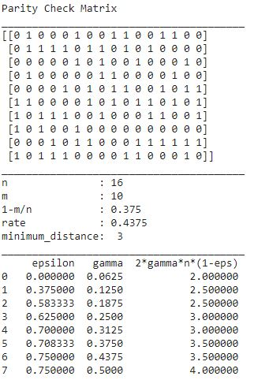
Some numbers

Slide 18
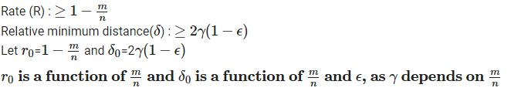
Asymptotic goodness
By suitably increasing m in proportion to n, we can still get rate and relative minimum distance both simultaneously bounded away from 0 for large n. The only requirement is proper construction of Expander graphs.
Thus these codes lie in pink region and are asymptotically good. Good modern expander construction methods and more complex ideas in code construction are sometimes observed to even reach GV bound for some rates and very often exceed baselines like Zyablov bound.

Slide 19
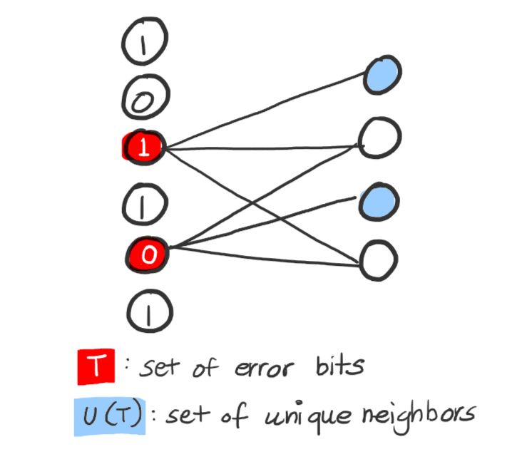
Decoding
How to clean up the codewords coming out of a messy channel, in linear time!

Slide 20
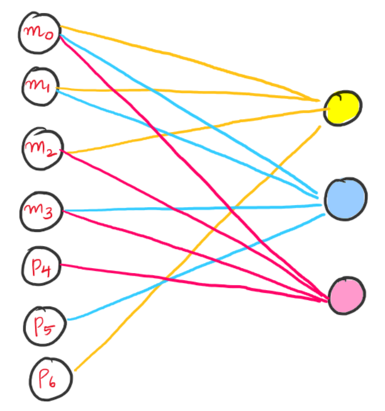
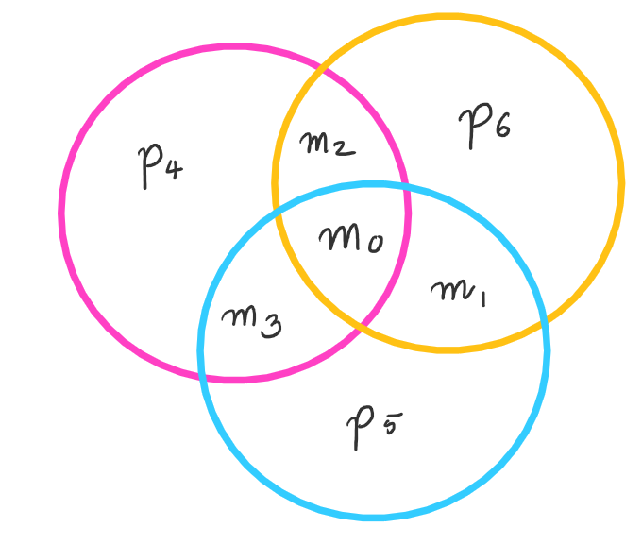
The Set-Up
Send a codeword through a channel, it comes out erroneous.
The Parity checks enforced by its Factor Graph no longer work.
We will use interesting properties of the Graph to decode this codeword in linear time

Slide 21
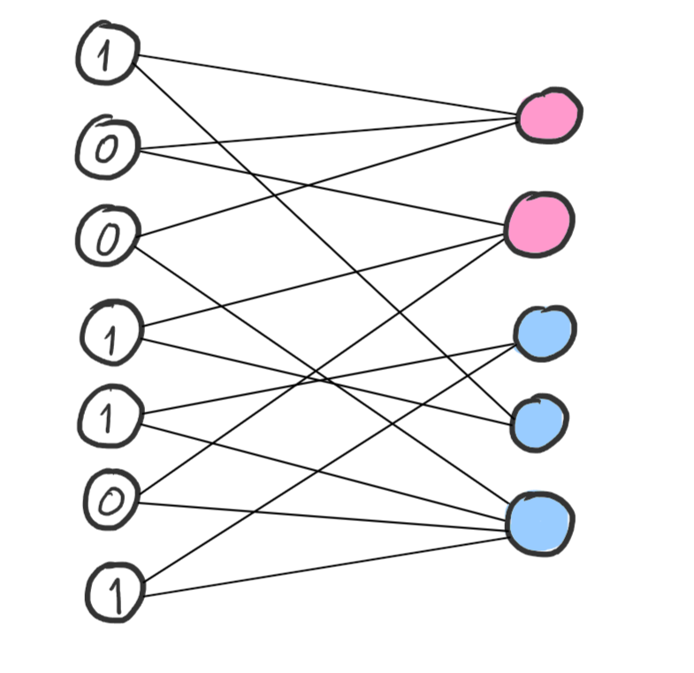
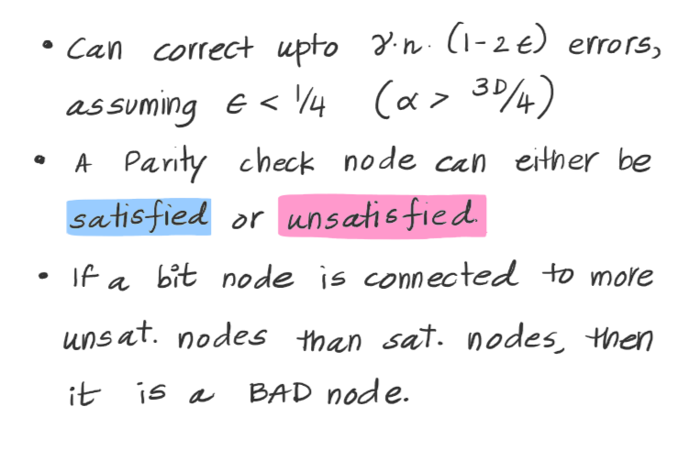
The Decoding Algorithm
BAD node

Slide 22
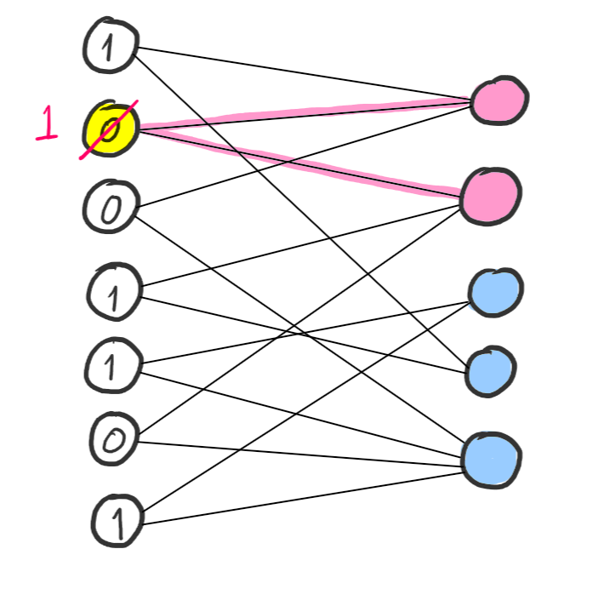
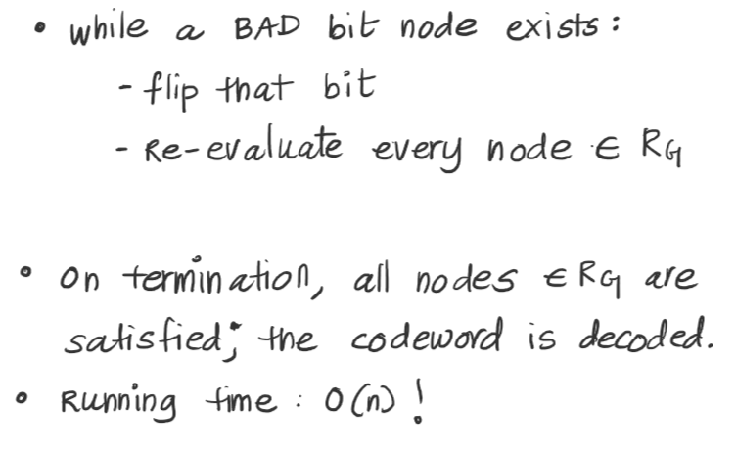
The Decoding Algorithm

Slide 23
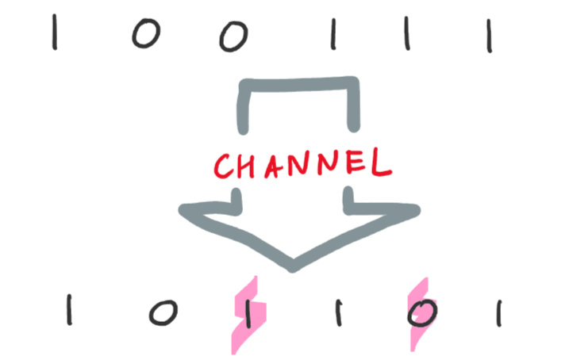
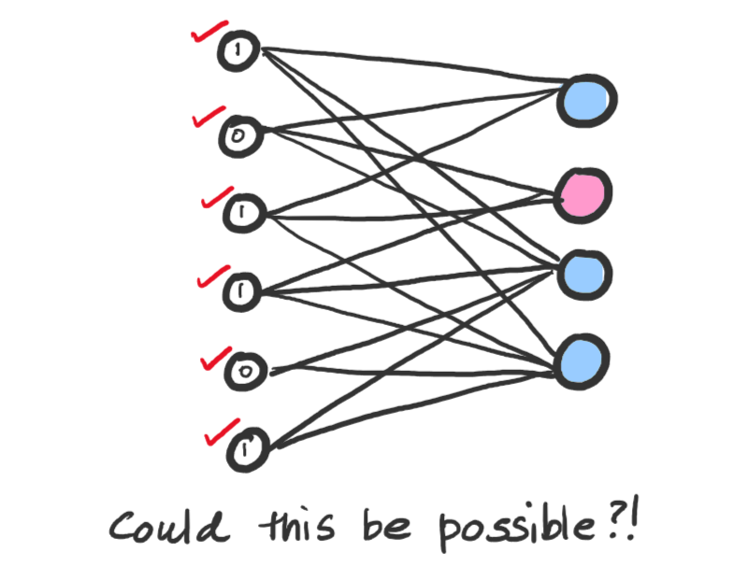
Why It works: Lemma 1
What if the algorithm never starts? (no BAD bit nodes)
Lemma 1: For < gn error bits, we will have at least one "BAD" node; provided € < ¼
Note the difference between a "BAD" bit node and an "erroneous" bit node.

Slide 24
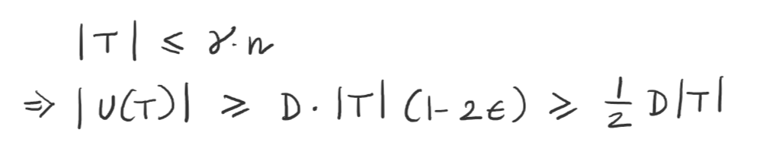
Lemma 1: Proof
Each node in U(T): unsatisfied! (why?)
Avg unsatisfied nodes connected to each node in T: |U(T)|/|T| = D/2
Because max ≥ avg, there must be at least one node in T which is connected to at least D/2 unsatisfied nodes. BAD node!

Slide 25
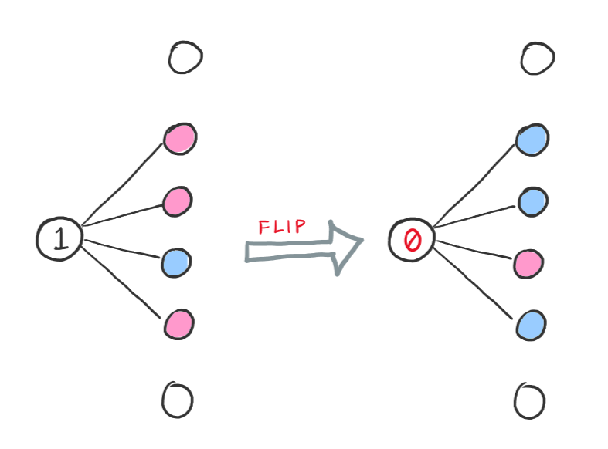
Lemma 2
Lemma 1 holds for < gn errors.
We start off with < gn(1-2e) errors.
Will our algorithm ever take us to a word with ≥ gn errors? (then Lemma 1 would break down)
Lemma 2 says NO.
Every time we flip a bit, the number of unsatisfied Parity nodes decreases by at least 1!

Slide 26
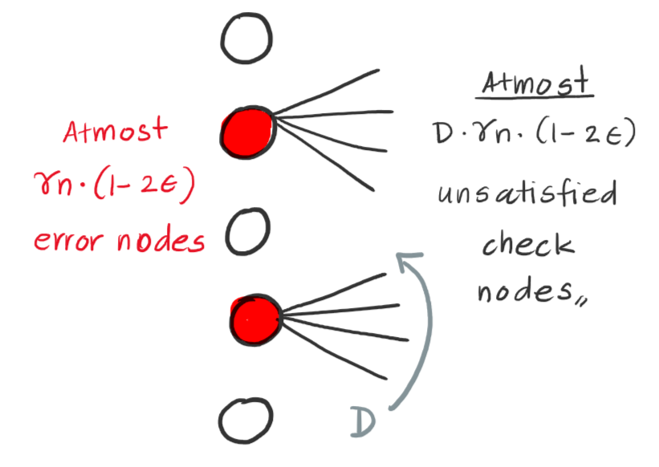
Lemma 2: Proof
Initially, < Dgn(1-2e) unsatisfied nodes.
Consider a time in the future we have ≥ gn error nodes.
Then |U(T)| ≥ D(1-2e)|T| = Dgn(1-2e).
Which is the same number of unsatisfied nodes we started off with.
Contradicts the fact that the number of unsatisfied nodes must decrease every iteration.

Slide 27
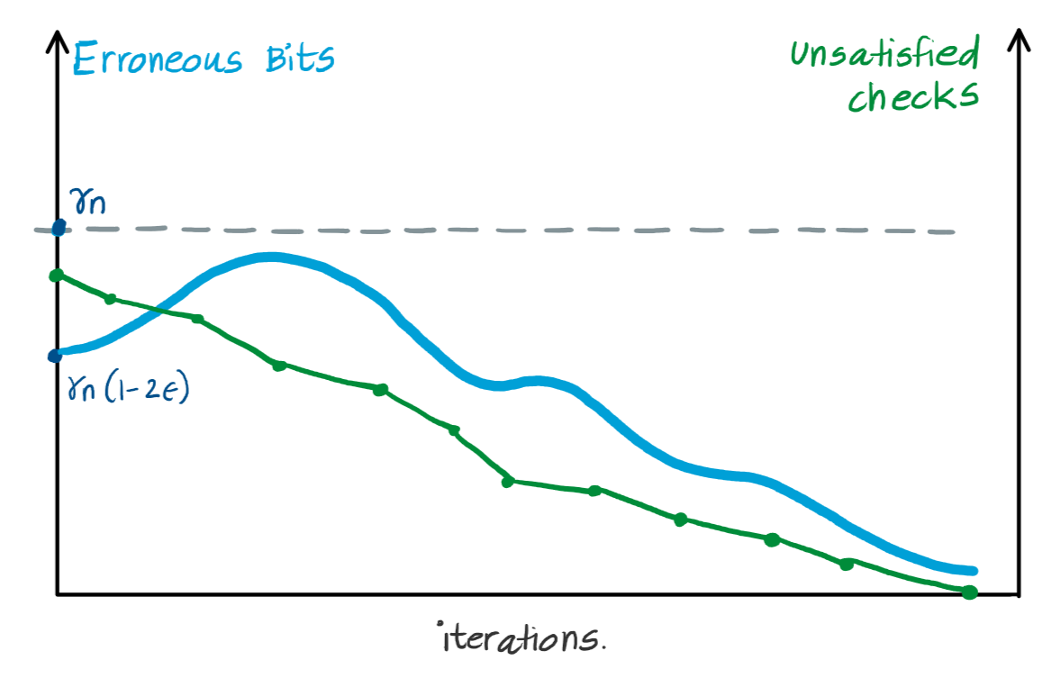
Correctness of the Algorithm
Lemma 1: for < gn errors, we will ALWAYS find at least one bad bit to flip.
Lemma 2 guarantees that we will never exceed gn errors in our codeword.

Slide 28
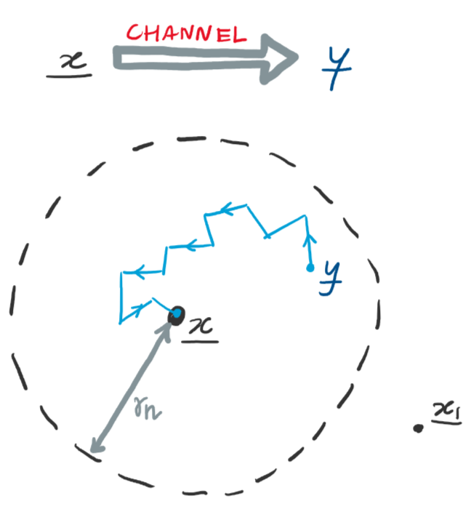
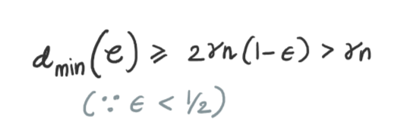
Correctness of the Algorithm
At termination, we must have zero unsatisfied check nodes.
Combining Lemma 1, Lemma 2, and the expression for d_{min}, we conclude that we decode to the correct codeword.

Slide 29

Running Time
How fast can we decode?

Slide 30
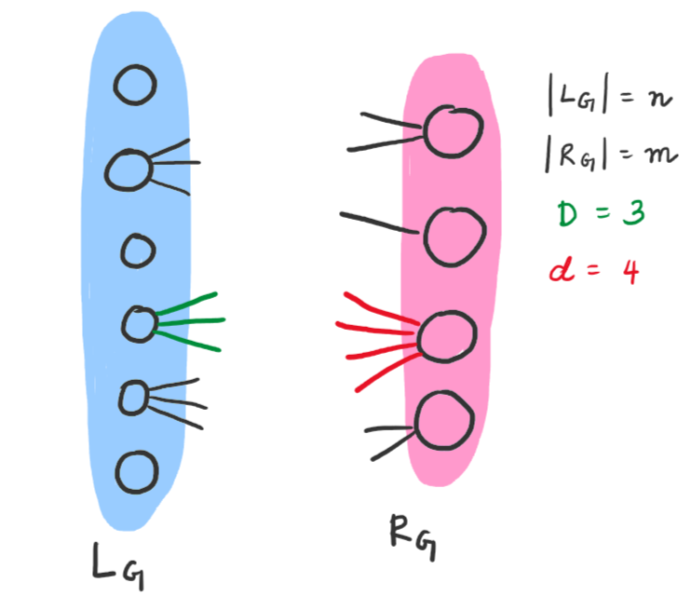
We Analyse:
Preprocessing
Each iteration
Number of Iterations
Notations:
n, m: Size of left and right sides
D: "D-left-regular" graph.
d: maximum degree of a node in R_{G}

Slide 31
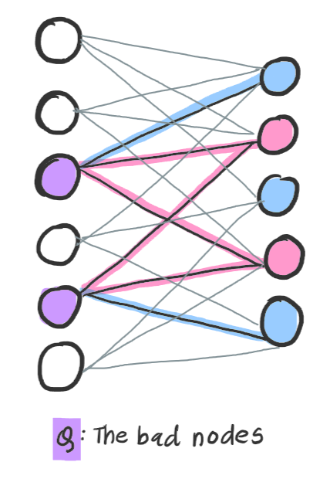
1. Preprocessing
1. Compute all unsatisfied nodes in R_{G}. 'm' nodes in R_{G}, and each has at most 'd' incoming connections to check. O(md) time.
2. Keep track of how many unsatisfied/satisfied nodes each bit node is connected to. 'n' bit nodes, and 'D' outgoing connections of each node. O(nD) time
3. Keep a list Q of all BAD nodes. O(n) time.

Slide 32
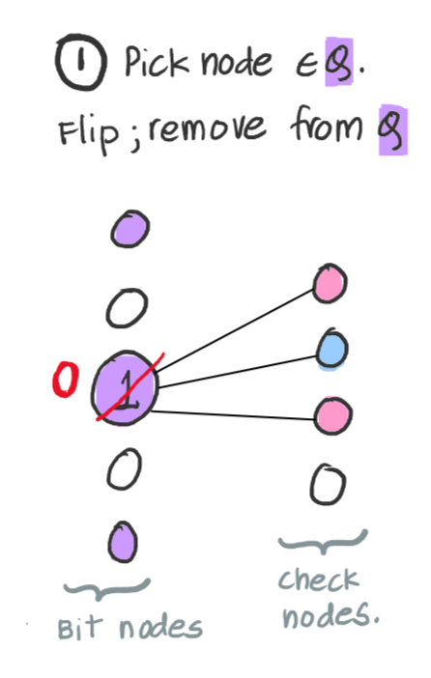
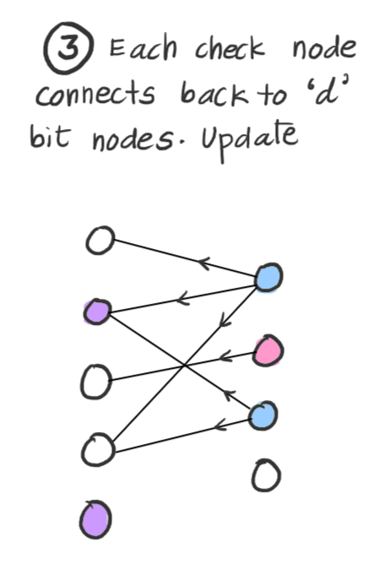
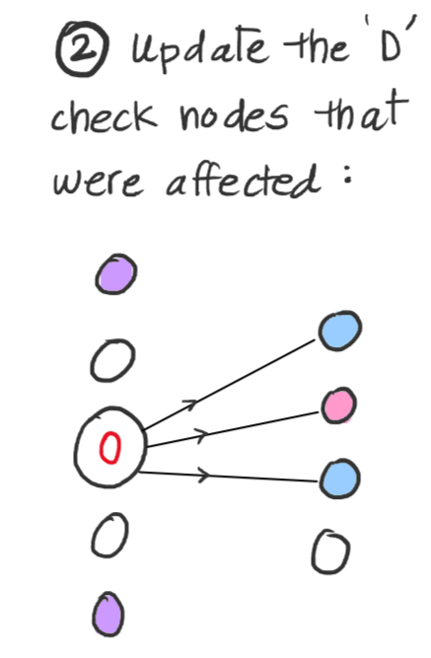
2. Each Iteration
O(1) time
O(D) time
O(Dd) time

Slide 33
Total Runtime
3. How many iterations?
Number of unsatisfied check nodes goes down by at least 1 every iteration.
There are a total of m check nodes.
So within m iterations, the algorithm must complete.
O(Dd) for each iteration, so O(mDd) for all the iterations.
O(mDd) for iterations.
O(nD) for the preprocessing.
Assume D and d are constants.
Assume n and m are of the same order.
Clearly, the total runtime of the algorithm happens in O(nD + mDd) = O(n). Linear time!!

Slide 34
Thank You!

Slide 35
References

